Slide 1
Chapter 2 Primitive Data Types and Operations
Introduce Programming with an Example
Identifiers, Variables, and Constants
Primitive Data Types
  byte, short, int, long, float, double, char, boolean
Expressions
Operators, Precedence, Associativity, Operand Evaluation Order: ++, --, *, /, %, +=, -=, *=, /=, %=, ^, &, |, +, -,
Getting Input from Input Dialog Boxes
Case Studies (Computing Mortgage, and Computing Changes)
Style and Documentation Guidelines
Syntax Errors, Runtime Errors, and Logic Errors

Slide 2
Introducing Programming with an Example
Example 2.1 Computing the Area of a Circle
This program computes the area of the circle.
ComputeArea
Run

Slide 3
Identifiers
An identifier is a sequence of characters that consist of letters, digits, underscores (_), and dollar signs ($).
An identifier must start with a letter, an underscore (_), or a dollar sign ($). It cannot start with a digit.
An identifier cannot be a reserved word. (See Appendix A, “Java Keywords,” for a list of reserved words).
An identifier cannot be true, false, or
null.
An identifier can be of any length.

Slide 4
Variables
// Compute the first area
radius = 1.0;
area = radius*radius*3.14159;
System.out.println("The area is “ + area + " for radius "+radius);
// Compute the second area
radius = 2.0;
area = radius*radius*3.14159;
System.out.println("The area is “ + area + " for radius "+radius);

Slide 5
Declaring Variables
int x; // Declare x to be an
// integer variable;
double radius; // Declare radius to
// be a double variable;
char a; // Declare a to be a
// character variable;

Slide 6
Assignment Statements
x = 1; // Assign 1 to x;
radius = 1.0; // Assign 1.0 to radius;
a = 'A'; // Assign 'A' to a;

Slide 7
Declaring and Initializing in One Step
int x = 1;
double d = 1.4;
float f = 1.4;
Is this statement correct?

Slide 8
Constants
final datatype CONSTANTNAME = VALUE;
final double PI = 3.14159;
final int SIZE = 3;

Slide 9
Numerical Data Types
byte 8 bits
short 16 bits
int 32 bits
long 64 bits
float 32 bits
double 64 bits

Slide 10
Operators
+, -, *, /, and %
5/2 yields an integer 2.
5.0/2 yields a double value 2.5
5 % 2 yields 1 (the remainder of the division)

Slide 11
NOTE
Calculations involving floating-point numbers are approximated because these numbers are not stored with complete accuracy. For example,
System.out.println(1 - 0.1 - 0.1 - 0.1 - 0.1 - 0.1);
displays 0.5000000000000001, not 0.5, and
System.out.println(1.0 - 0.9);
displays 0.09999999999999998, not 0.1. Integers are stored precisely. Therefore, calculations with integers yield a precise integer result.

Slide 12
Number Literals
A literal is a constant value that appears directly in the program. For example, 34, 1,000,000, and 5.0 are literals in the following statements:
int i = 34;
long l = 1000000;
double d = 5.0;

Slide 13
Integer Literals
An integer literal can be assigned to an integer variable as long as it can fit into the variable. A compilation error would occur if the literal were too large for the variable to hold. For example, the statement byte b = 1000 would cause a compilation error, because 1000 cannot be stored in a variable of the byte type.
An integer literal is assumed to be of the int type, whose value is between -2³¹ (-2147483648) to 2³¹–1 (2147483647). To denote an integer literal of the long type, append it with the letter L or l. L is preferred because l (lowercase L) can easily be confused with 1 (the digit one).

Slide 14
Floating-Point Literals
Floating-point literals are written with a decimal point. By default, a floating-point literal is treated as a double type value. For example, 5.0 is considered a double value, not a float value. You can make a number a float by appending the letter f or F, and make a number a double by appending the letter d or D. For example, you can use 100.2f or 100.2F for a float number, and 100.2d or 100.2D for a double number.

Slide 15
Scientific Notation
Floating-point literals can also be specified in scientific notation, for example, 1.23456e+2, same as 1.23456e2, is equivalent to 123.456, and 1.23456e-2 is equivalent to 0.0123456. E (or e) represents an exponent and it can be either in lowercase or uppercase.

Slide 16

Arithmetic Expressions
is translated to
(3+4*x)/5 – 10*(y-5)*(a+b+c)/x + 9*(4/x + (9+x)/y)

Slide 17
Shortcut Assignment Operators
Operator Example Equivalent
+= i+=8 i = i+8
-= f-=8.0 f = f-8.0
*= i*=8 i = i*8
/= i/=8 i = i/8
%= i%=8 i = i%8

Slide 18
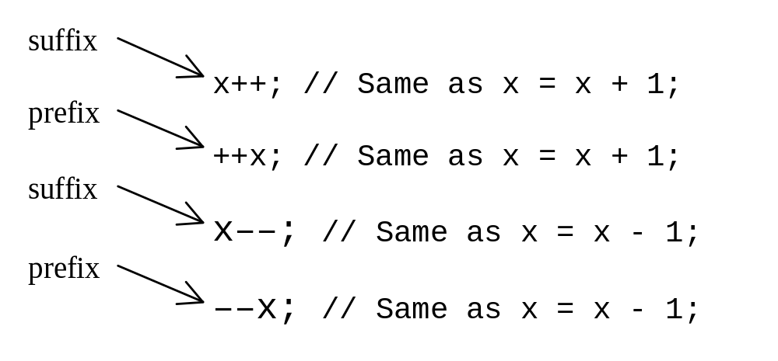
Increment and
Decrement Operators

Slide 19
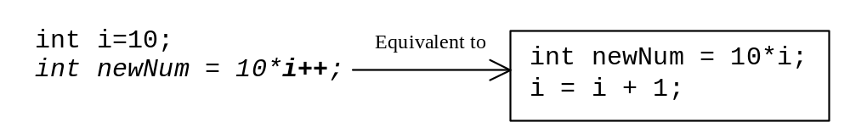
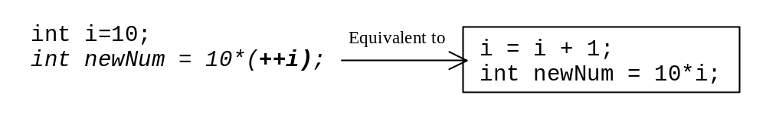
Increment and
Decrement Operators, cont.

Slide 20
Increment and
Decrement Operators, cont.
Using increment and decrement operators makes expressions short, but it also makes them complex and difficult to read. Avoid using these operators in expressions that modify multiple variables, or the same variable for multiple times such as this: int k = ++i + i.

Slide 21
Assignment Expressions and Assignment Statements
Prior to Java 2, all the expressions can be used as statements. Since Java 2, only the following types of expressions can be statements:
variable op= expression; // Where op is +, -, *, /, or %
++variable;
variable++;
--variable;
variable--;

Slide 22
Numeric Type Conversion
Consider the following statements:
byte i = 100;
long k = i*3+4;
double d = i*3.1+k/2;
int x = k; //(Wrong)
long k = x; //(fine,implicit casting)

Slide 23
Type Casting
double
float
long
int
short
byte

Slide 24
Type Casting, cont.
Implicit casting
double d = 3; (type widening)
Explicit casting
int i = (int)3.0; (type narrowing)
What is wrong? int x = 5/2.0;

Slide 25
Character Data Type
char letter = 'A'; (ASCII)
char numChar = '4'; (ASCII)
char letter = '\u0041'; (Unicode)
char numChar = '\u0034'; (Unicode)
Special characters
char tab = ‘\t’;

Slide 26
Unicode Format
Description Escape Sequence Unicode
Backspace \b \u0008
Tab \t \u0009
Linefeed \n \u000a
Carriage return \r \u000d

Slide 27

Appendix B: ASCII Character Set
ASCII Character Set is a subset of the Unicode from \u0000 to \u007f

Slide 28

ASCII Character Set, cont.
ASCII Character Set is a subset of the Unicode from \u0000 to \u007f

Slide 29
Casting between char and Numeric Types
int i = 'a'; // Same as int i = (int)'a';
char c = 97; // Same as char c = (char)97;

Slide 30
The boolean Type and Operators
boolean lightsOn = true;
boolean lightsOn = false;
boolean b = (1 > 2);
&& (and) (1 < x) && (x < 100)
|| (or) (lightsOn) || (isDayTime)
! (not) !(isStopped)

Slide 31
Comparison Operators
Operator Name
< less than
<= less than or equal to
> greater than
>= greater than or equal to
== equal to
!= not equal to

Slide 32
Boolean Operators
Operator Name
! not
&& and
|| or
^ exclusive or

Slide 33
Truth Table for Operator !
Truth Table for Operator !
Operand !Operand
true false
false true

Slide 34
Truth Table for Operator &&
Operand1 Operand2 Operand1 && Operand2
false false false
false true false
true false false
true true true

Slide 35
Truth Table for Operator ||
Operand1 Operand2 Operand1 || Operand2
false false false
false true true
true false true
true true true

Slide 36
Truth Table for Operator ^
Operand1 Operand2 Operand1 ^ Operand2
false false false
false true true
true false true
true true false

Slide 37
The & and | Operators
&&: conditional AND operator
&: unconditional AND operator
||: conditional OR operator
|: unconditional OR operator
exp1 && exp2
(1 < x) && (x < 100)
(1 < x) & (x < 100)

Slide 38
The & and | Operators
If x is 1, what is x after this expression?
(x > 1) & (x++ < 10)
If x is 1, what is x after this expression?
(1 > x) && ( 1 > x++)
How about (1 == x) | (10 > x++)?
(1 == x) || (10 > x++)?

Slide 39
Operator Precedence
How to evaluate
3 + 4 * 4 > 5 * (4 + 3) - ++i

Slide 40
Operator Precedence
var++, var--
+, - (Unary plus and minus), ++var,--var
(type) Casting
! (Not)
*, /, % (Multiplication, division, and modulus)
+, - (Binary addition and subtraction)
<, <=, >, >= (Comparison)
==, !=; (Equality)
& (Unconditional AND)
^ (Exclusive OR)
| (Unconditional OR)
&& (Conditional AND) Short-circuit AND
|| (Conditional OR) Short-circuit OR
=, +=, -=, *=, /=, %= (Assignment operator)

Slide 41
Operator Associativity
When two operators with the same precedence are evaluated, the associativity of the operators determines the order of evaluation. All binary operators except assignment operators are left-associative.
a – b + c – d is equivalent to ((a – b) + c) – d
Assignment operators are right-associative. Therefore, the expression
a = b += c = 5 is equivalent to a = (b += (c = 5))

Slide 42
Operand Evaluation Order
The precedence and associativity rules specify the order of the operators, but do not specify the order in which the operands of a binary operator are evaluated. Operands are evaluated from left to right in Java.
The left-hand operand of a binary operator is evaluated before any part of the right-hand operand is evaluated.

Slide 43
Operand Evaluation Order, cont.
If no operands have side effects that change the value of a variable, the order of operand evaluation is irrelevant. Interesting cases arise when operands do have a side effect. For example, x becomes 1 in the following code, because a is evaluated to 0 before ++a is evaluated to 1.
  int a = 0;
  int x = a + (++a);
But x becomes 2 in the following code, because ++a is evaluated to 1, then a is evaluated to 1.
  int a = 0;
  int x = ++a + a;

Slide 44
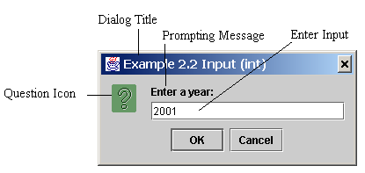
Getting Input from Input Dialog Boxes
String string = JOptionPane.showInputDialog(
null, “Prompt Message”, “Dialog Title”,
JOptionPane.QUESTION_MESSAGE));
where x is a string for the prompting message and y is a string for the title of the input dialog box.

Slide 45
Convertting Strings to Integers
The input returned from the input dialog box is a string. If you enter a numeric value such as 123, it returns “123”. To obtain the input as a number, you have to convert a string into a number.
To convert a string into an int value, you can use the static parseInt method in the Integer class as follows:
int intValue = Integer.parseInt(intString);
where intString is a numeric string such as “123”.

Slide 46
Convertting Strings to Doubles
To convert a string into a double value, you can use the static parseDouble method in the Double class as follows:
double doubleValue =Double.parseDouble(doubleString);
where doubleString is a numeric string such as “123.45”.

Slide 47
Example 2.2
Entering Input from Dialog Boxes
This program first prompts the user to enter a year as an int value and checks if it is a leap year, it then prompts you to enter a double value and checks if it is positive.
A year is a leap year if it is divisible by 4 but not by 100, or it is divisible by 400.
InputDialogDemo
Run

Slide 48
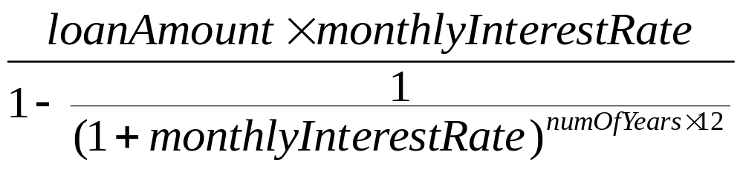
Example 2.3
Computing Mortgages
This program lets the user enter the interest rate, number of years, and loan amount and computes monthly payment and total payment.
ComputeMortgage
Run

Slide 49
Example 2.4
Computing Changes
This program lets the user enter the amount in decimal representing dollars and cents and output a report listing the monetary equivalent in single dollars, quarters, dimes, nickels, and pennies. Your program should report maximum number of dollars, then the maximum number of quarters, and so on, in this order.
ComputeChange
Run

Slide 50
Programming Style and Documentation
Appropriate Comments
Naming Conventions
Proper Indentation and Spacing Lines
Block Styles

Slide 51
Appropriate Comments
Include a summary at the beginning of the program to explain what the program does, its key features, its supporting data structures, and any unique techniques it uses.
Include your name, class section, instruction, date, and a brief description at the beginning of the program.

Slide 52
Naming Conventions
Choose meaningful and descriptive names.
Variables and method names:
  Use lowercase. If the name consists of several words, concatenate all in one, use lowercase for the first word, and capitalize the first letter of each subsequent word in the name. For example, the variables radius and area, and the method computeArea.

Slide 53
Naming Conventions, cont.
Class names:
  Capitalize the first letter of each word in the name. For example, the class name ComputeArea.
Constants:
  Capitalize all letters in constants. For example, the constant PI.

Slide 54
Proper Indentation and Spacing
Indentation
  Indent two spaces.
Spacing
  Use blank line to separate segments of the code.

Slide 55

Block Styles
Use end-of-line style for braces.

Slide 56
Programming Errors
Syntax Errors
  Detected by the compiler
Runtime Errors
  Causes the program to abort
Logic Errors
  Produces incorrect result

Slide 57
Compilation Errors
public class ShowSyntaxErrors {
public static void main(String[] args) {
i = 30;
System.out.println(i+4);
}
}

Slide 58
Runtime Errors
public class ShowRuntimeErrors {
public static void main(String[] args) {
int i = 1 / 0;
}
}

Slide 59
Logic Errors
public class ShowLogicErrors {
// Determine if a number is between 1 and 100 inclusively
public static void main(String[] args) {
// Prompt the user to enter a number
String input = JOptionPane.showInputDialog(null,
"Please enter an integer:",
"ShowLogicErrors", JOptionPane.QUESTION_MESSAGE);
int number = Integer.parseInt(input);
// Display the result
System.out.println("The number is between 1 and 100, " +
"inclusively? " + ((1 < number) && (number < 100)));
System.exit(0);
}
}

